Slide 1

Towards performance tuning mindset
Presenter Viorel Chelaru
Senior Java Developer @ METRO Systems

Slide 2
About me
Viorel Chelaru
Mathematics & Computer Science @ UGAL
Master in Artificial Intelligence @ PUB
Java developer for 15 years
Challenging projects keep me alive

Slide 3
Do we really need fast Java code ?
I never heard a client say:
I am happy the 100 lines CSV upload takes 30 minutes.
Black Friday : websites slow, until they go down
Cashier desk in store: card payment takes 10 minutes

Slide 4
Do we really need fast Java code ?
I never heard a client say:
I am happy the 100 lines CSV upload takes 30 minutes.
Black Friday : websites slow, until they go down
Cashier desk in store: card payment takes 10 minutes
Software performance affects our lives

Slide 5
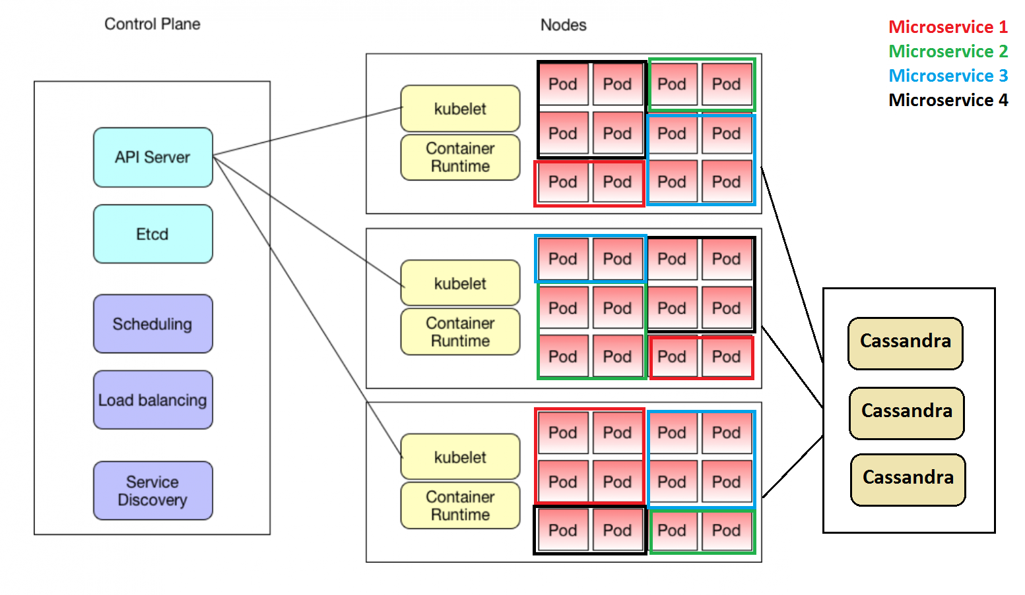
ODIN project @ METRO
Task processing system
REST uService in SpringBoot
Deployed in Docker on Kubernetes
14 uServices
~200 pods on 15 nodes
2-80 pods per uService

Slide 6
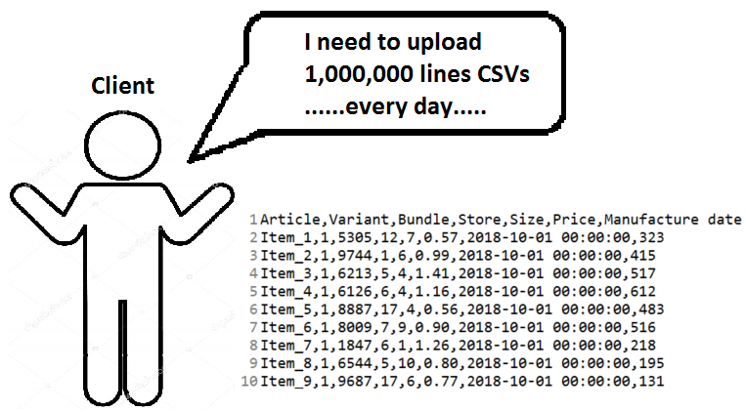
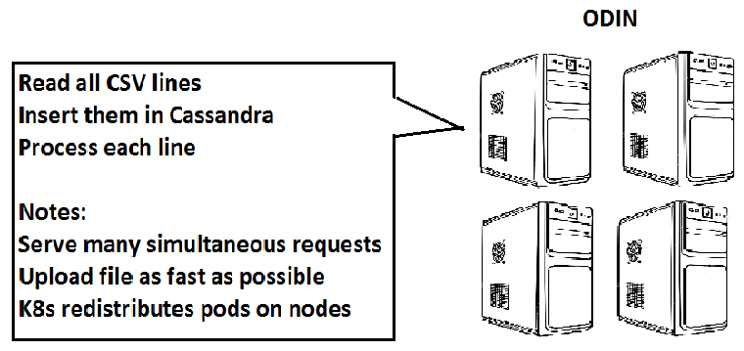
Use case : Big file upload

Slide 7
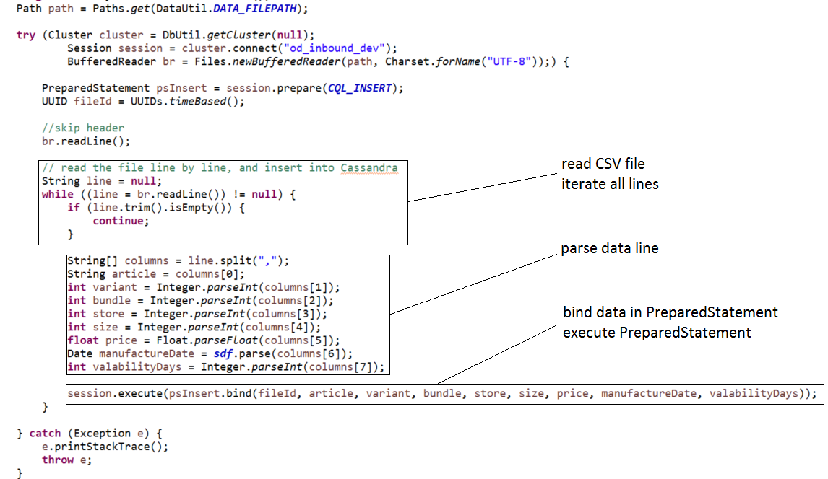
It’s easy to implement a file upload

Slide 8
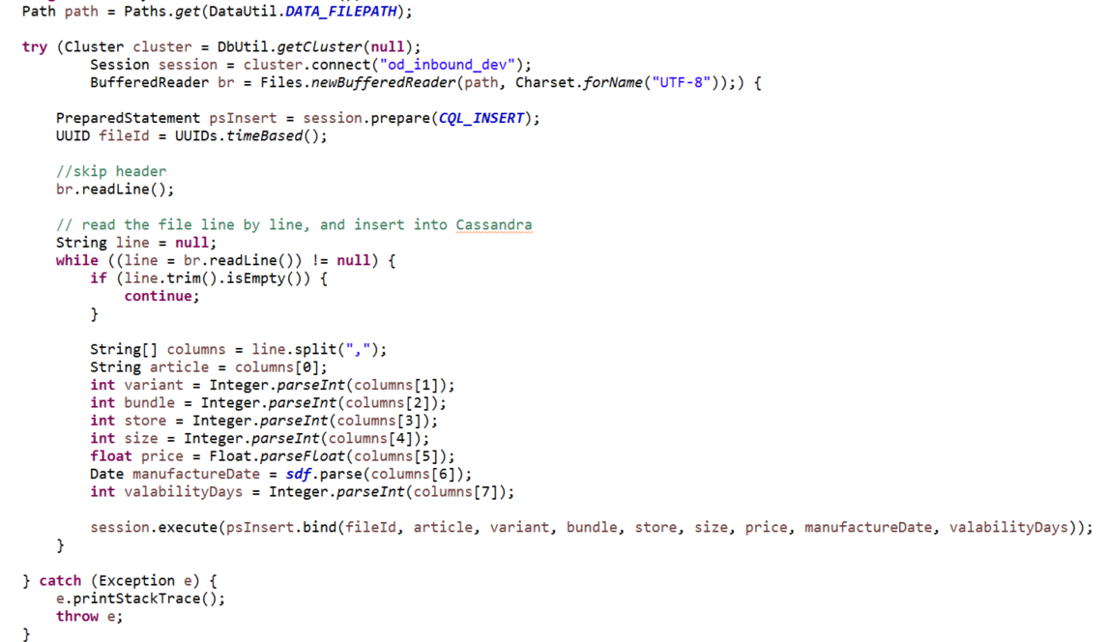
It’s easy ??? to implement a file upload
Runs in ~22 hours
30Mb memory footprint

Slide 9
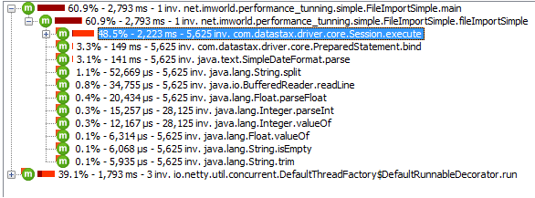
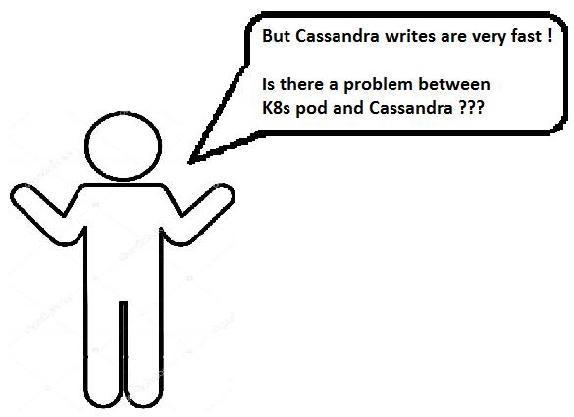
Profiling to find the cause

Slide 10
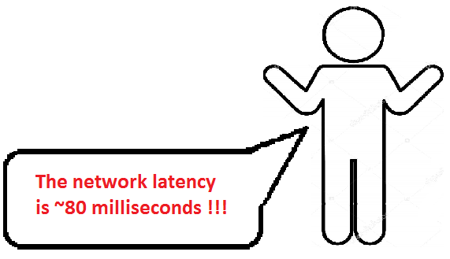
Profiling to find the cause

Slide 11
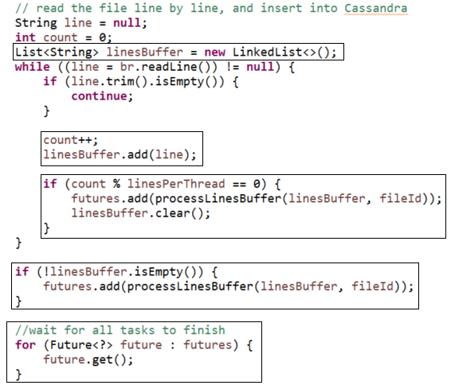
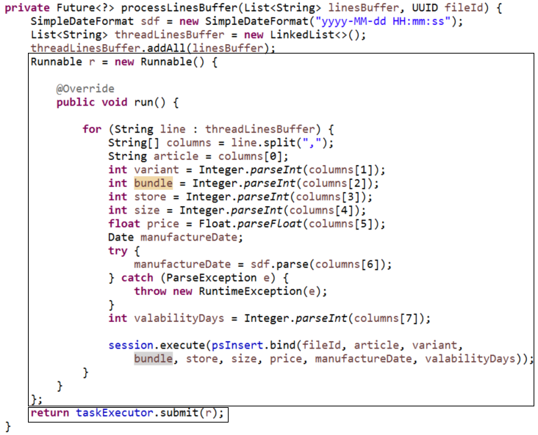
Multi-threading is faster !

Slide 12
Multi-threading is faster !
2 parameters to adjust
- #lines per thread
- #threads in the pool

Slide 13
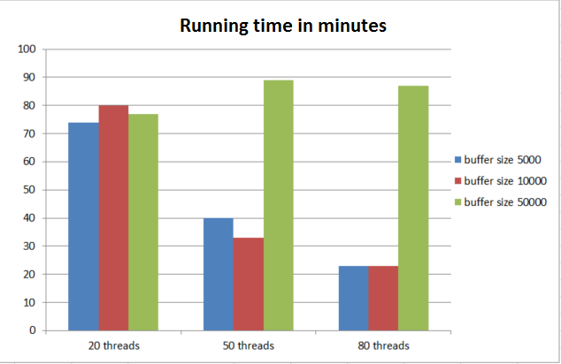
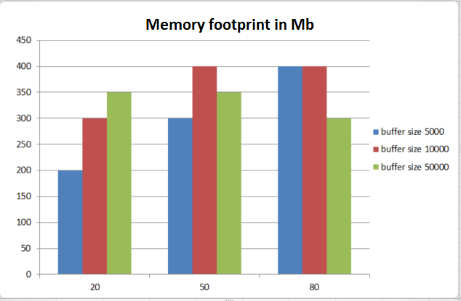
Multi-threading results
Multi-threading solution:
read 1,000,000 lines with a pool of 80 threads, each thread inserting 10,000 lines
Running time 23 mins
Memory footprint 400 Mb
Using Cassandra SimpleStatement (CQL concat), not binding to a PreparedStatement
- Running time 18 mins

Slide 14
Multi-threading results
Multi-threading solution:
read 1,000,000 lines with a pool of 80 threads, each thread inserting 10,000 lines
Running time 23 mins
Memory footprint 400 Mb
Using Cassandra SimpleStatement (CQL concat), not binding to a PreparedStatement
- Running time 18 mins
Still NOT HAPPY ! 18 minutes is too much !
1 pod has 450Mb required memory !

Slide 15
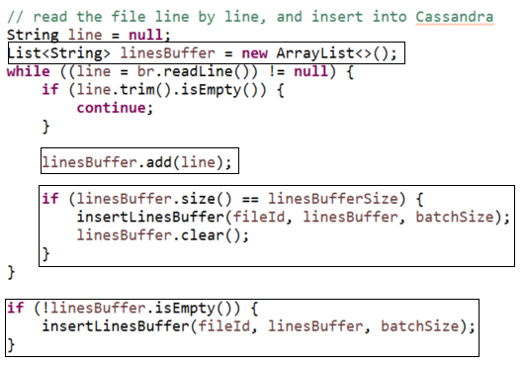
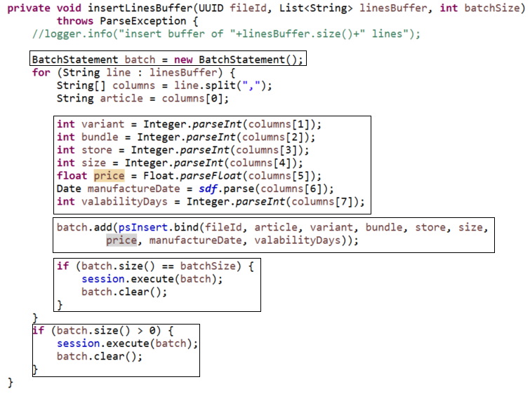
Inserting with Cassandra batches
Benefit:
send multiple statements in 1 network call

Slide 16
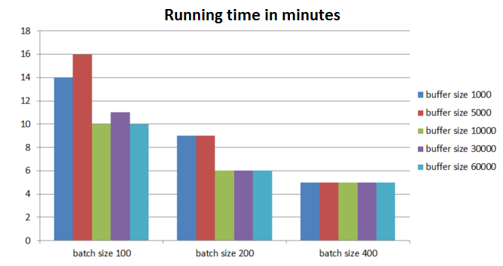
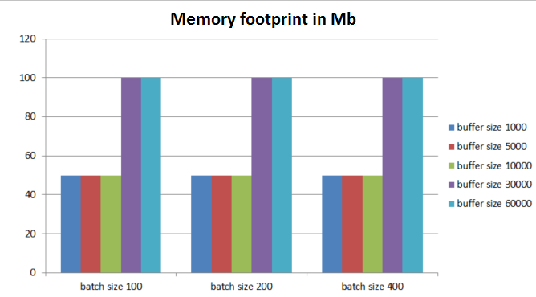
Inserting with Cassandra batches
Cassandra Batches solution:
read 1,000,000 lines in buffers of 1000 lines, insert buffers in baches of 400 inserts
Running time 5 mins
Memory footprint 50 Mb
Using Cassandra SimpleStatement (CQL concat), not binding to a PreparedStatement
- Running time 11 mins

Slide 17
Inserting with Cassandra batches
Cassandra Batches solution:
read 1,000,000 lines in buffers of 1000 lines, insert buffers in batches of 400 inserts
Running time 5 mins
Memory footprint 50 Mb
Using Cassandra SimpleStatement (CQL concat), not binding to a PreparedStatement
- Running time 11 mins
We’re getting somewhere ! 5 minutes is pretty good, but can I do better ?

Slide 18
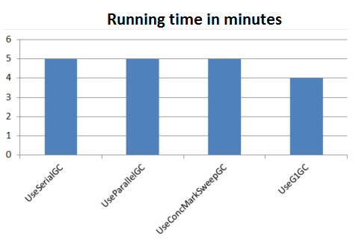
Does Garbage Collection count ?
Cassandra Batches solution:
read 1,000,000 lines in buffers of 1000 lines
insert buffers in batches of 400 inserts
Use G1 garbage collector
Running time 4 mins
Memory footprint 50 – 80 Mb

Slide 19
Does Garbage Collection count ?
Cassandra Batches solution:
read 1,000,000 lines in buffers of 1000 lines
insert buffers in batches of 400 inserts
Use G1 garbage collector
Running time 4 mins
Memory footprint 50 – 80 Mb
Wowww, I just squized 1 MINUTE !
4 minutes is niceee….
I can see the end of the tunnel !

Slide 20
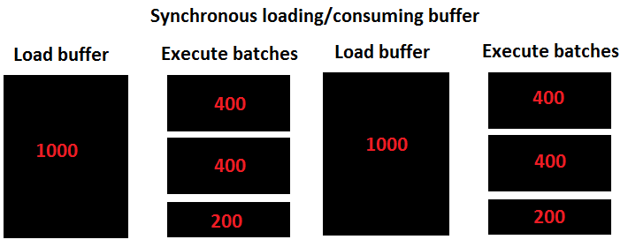
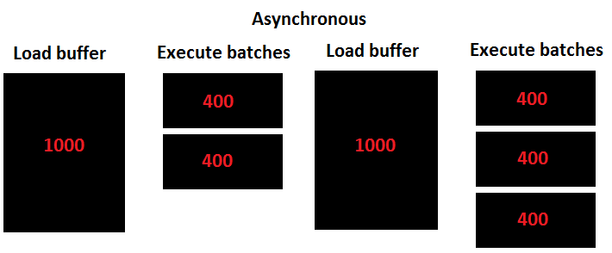
3000 batches ? Should be 2500 batches !
Until now
1,000,000 lines read in buffers of 1000 lines
Insert each buffer in 400 inserts batches
1000 lines
1 buffer => 3 batches (400,400,200)
1,000,000 lines
1000 buffers * 3 batches / buffer = 3000 batches
But
1,000,000 lines / 400 inserts = 2500 batches !!!!
Does it worth optimizing ?
500 batches * 80ms latency / batch = 40 seconds

Slide 21
Final solution
Use Cassandra batches (single partition)
read 1,000,000 lines in buffers of 1000 lines
insert buffers in batches of 400 inserts
Decouple loading buffer and executing insert batches
Use G1 garbage collector
Running time 3 mins
Memory footprint 50 – 80 Mb
From 22 hours to 3 minutes ??? What a journey !
We improve 440 times !!
I can go like this “forever” ☺

Slide 22
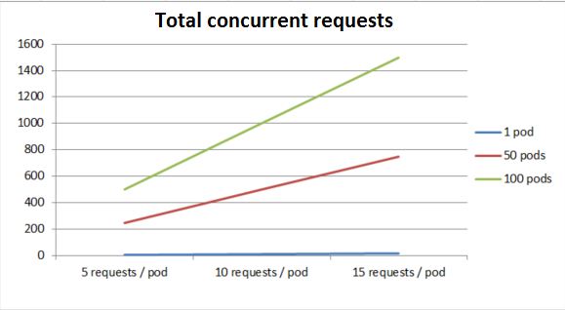
Performance & Scalability

Slide 23
I don’t have to be a genius to fine tune performance
I am restless, ambitious , skeptical, always unsatisfied !
I always keep performance in mind when I code.
I HAVE time for performance tuning, if I prioritize my work.
I use my analytical thinking, not my typing skills.

Slide 24
THINK !
IT AIN’T ILLEGAL …. YET
Eddie Griffin, The comedian

Slide 25
Thank You !
Questions ?
Code is on GitHub, look me up

